Slide 1
Attendance System using Company Badge

Slide 2






Record attendance in Excel name list
Block Diagram
SCAN
DATA EXTRACTION & PROCESSING
RECORD
Employee Name
Employee ID
Timestamp
Attendance

Slide 3
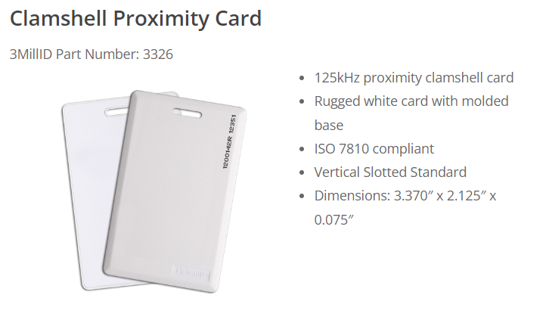
Challenges
1. Frequency of RFID card and RFID scanner
Company: 3millID
Frequency: 125 kHz or 13.65 MHz

Slide 4



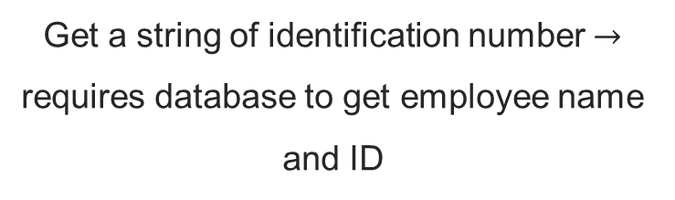
Challenges
2. Output of RFID scanner after scanning badge
Get employee name and ID
Get a string of identification number $→$ requires database to get employee name and ID
Might require security access to company database

Slide 5
Questions
Way to store data
1st Option | 2nd Option
Record employee name and ID with timestamp and attendance in a new Excel file | Get employee name and ID Compare with name list in Excel / database Record timestamp and attendance

Slide 6

Future Improvements
GUI to initiate/pause scanning and display messages
Add in start / stop scanning button
Display success message when information is recorded in database (Excel sheet)
Graphical User Interface (GUI)

